Slide 1
Horse colic dataset
The main aim of this project is to classify if adult horses will succumb after being diagnosed with colic. Finding what attributes have a high correlation with the horse dying or being euthanized.
The aim is to get the smallest tree, choosing the attribute that produces the purest nodes, that is the greatest information gain.
Information gain, amount of information gained by knowing the value of the attribute
Entropy of distribution before the split vs the entropy after the split

Slide 2
Horse colic dataset
300 samples, 28 features
21 float64
4 int 64
3 objects (data about lesion types)
I removed 9 features –
50-82% missing data in one
Not relevant according to the data description
Hospital number (284 unique values of 300 total)
I also removed noisy data
8% of the data is from 6 month old horses or younger, they have a much higher death rate, the values are extremely fluctuating compared to adult horses. (Higher pulse, respiratory rate, narrower temperature range)
I discretisized values to simplify classification in the tree
Temperature, low, normal, high
Pulse, low, normal, high
Protein levels in blood
Mucous membrane (tongue color)

Slide 3
Data exploring
I performed the data cleaning in Python.
I also decided to try doing PCA because of the high dimensionality, to find the variance in the data using Scikit package in python

Slide 4
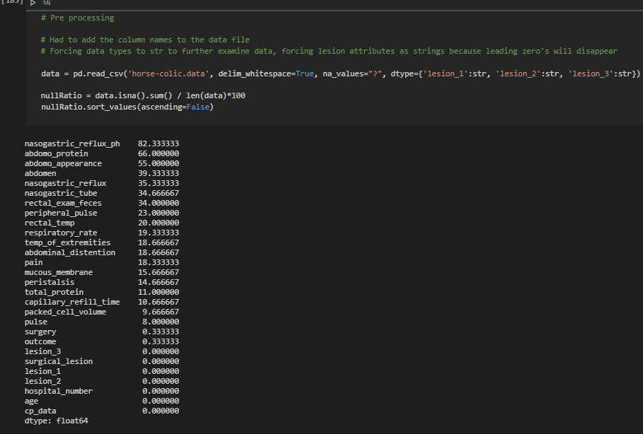
Data prep
A lot of missing data
Numbers are the ratio of
Missing data, 82.3% is the most

Slide 5
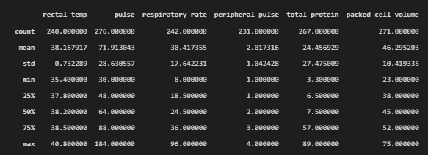
Data examination – Before data prep
High standard deviation in pulse, respiratory rate and protein levels
High range of values, mostly because of (8% young horses in the dataset)

Slide 6
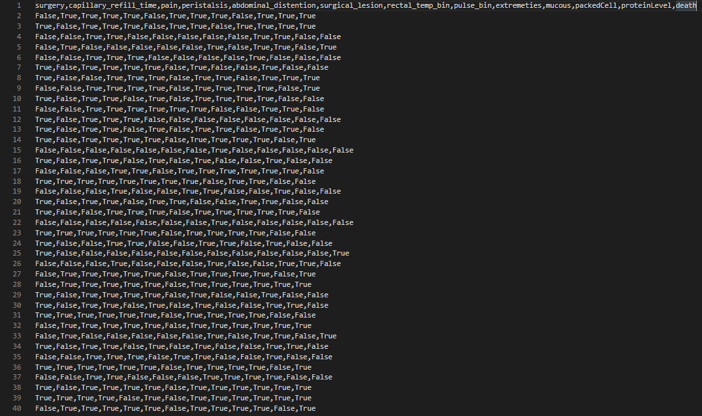
Data prep
Converted to True/False values.
If the horse had :
Surgery
Long breathing
Pain
Peristalsis
Abdominal distension
Surgical lesions
High rectal temp
High pulse
Heat in extremities
Coloration of mucous
High cell count
High protein levels

Slide 7
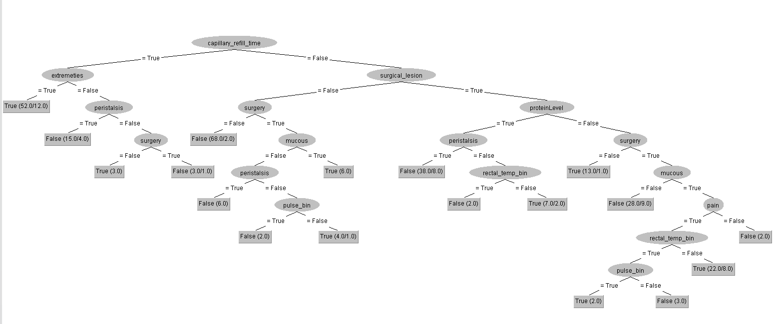
C4.5 tree generated with 13 attributes
A lot of leaf nodes with few cases, although good classifications but this may lead to over classification
By using this tree I got 74.6% correct classification.

Slide 8
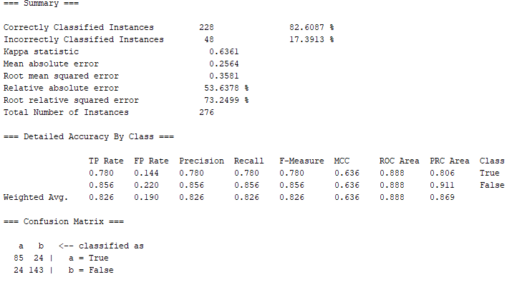
Summary

Slide 9
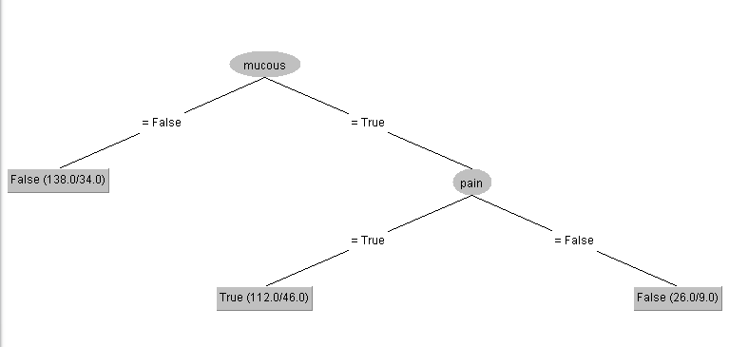
C4.5 tree generated with 7 attributes
The algorithm ignored quite a few of the attributes but still gets a good classification. It only uses two of the 7 total attributes.
Few nodes with many cases, somewhat accurate clasifications but many misclassifications.
By using this tree I got 67% correct classification.
However I feel that using only two attributes is way to little data to rely on.
I tried playing with the variables, removing one or two from 13. But that always seemed to lead to overpruning
I would chose the first model because of the accuracy. Fewer attributes are omitted, but I would like to have time to play a little bit more with the pruning.

Slide 10
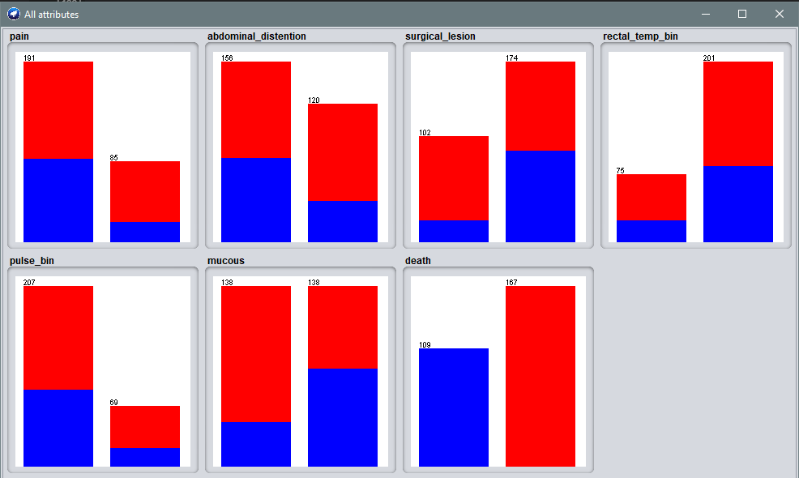
Attributes – blue = dead horse

Slide 11
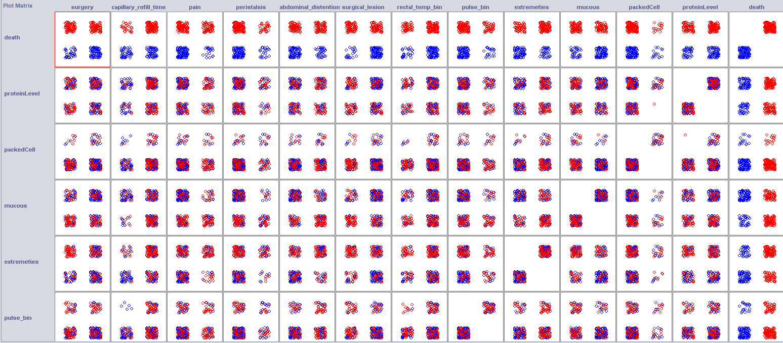
Lessons learned
Blue indicates death

Slide 12
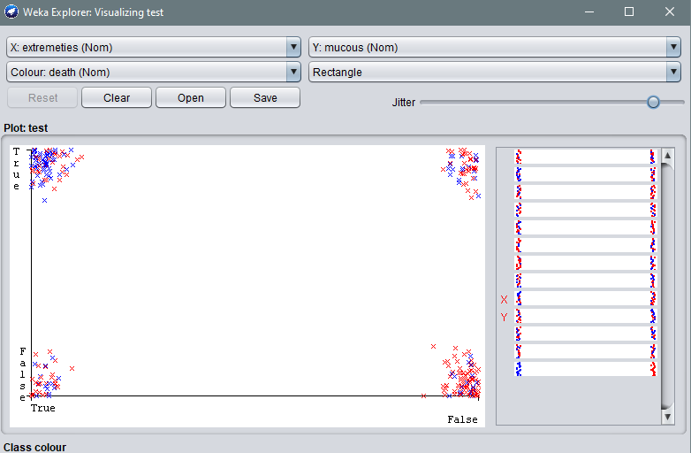
Lessons learned
Blue = Dead
Correlation between temperature in extremities and coloration of mucous.
If the horses have signs of discoloration of the mucous and heat in the extremities they are likely to be classified as dead

Slide 13
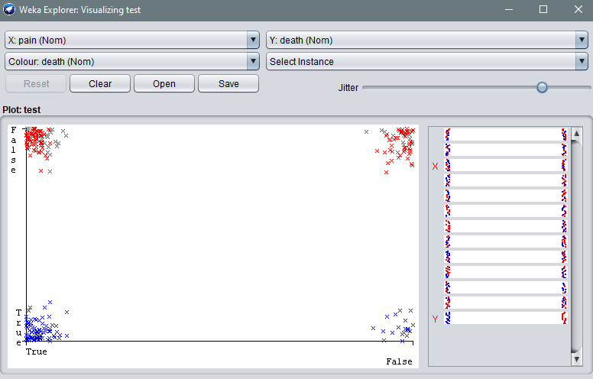
Lessons learned
Blue = Dead (true)
Correlation between pain and death, a lot of horses that show pain levels are dead

Slide 14
fin
All code is on github, including python and weka
https://github.com/andriOlafsson/horseColic
Data cleaning was performed in a jupyter notebook that can be run online
https://nbviewer.jupyter.org/github/andriOlafsson/horseColic/blob/master/jupyter.ipynb
Thank you
- Andri Ólafsson

